Slide 1
Vectors as Forces

Slide 2
Generally speaking, force can be defined as that which changes, or tends to change, the state of rest, or uniform motion of a body.
The description of a force’s magnitude, without also specifying its direction, has little practical value. Since force has a magnitude and direction, therefore force is a vector.

Slide 3
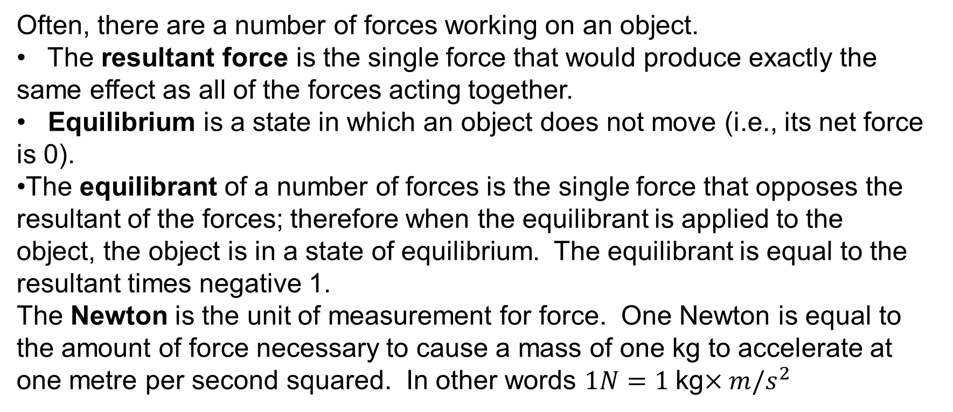
Often, there are a number of forces working on an object.
The resultant force is the single force that would produce exactly the same effect as all of the forces acting together.
Equilibrium is a state in which an object does not move (i.e., its net force is 0).
The equilibrant of a number of forces is the single force that opposes the resultant of the forces; therefore when the equilibrant is applied to the object, the object is in a state of equilibrium. The equilibrant is equal to the resultant times negative 1.
The Newton is the unit of measurement for force. One Newton is equal to the amount of force necessary to cause a mass of one kg to accelerate at one metre per second squared. In other words $1N=1$kg$×{m/s}^{2}$

Slide 4
Example
Two children, James and Fred, are pushing on a rock. James pushes with a force of 80 N in an easterly direction and Fred pushes with a force of 60 N in the same direction.
Determine the resultant and the equilibrant of these two forces.

Slide 5
Two children, James and Fred, are pushing on a rock. James pushes with a force of 80 N in an easterly direction and Fred pushes with a force of 60 N in the same direction.
Determine the resultant and the equilibrant of these two forces.
Solution:
80 N
60 N

Slide 6
Two children, James and Fred, are pushing on a rock. James pushes with a force of 80 N in an easterly direction and Fred pushes with a force of 60 N in the same direction.
Determine the resultant and the equilibrant of these two forces.
Solution:
Therefore the resultant is 140 N in an easterly direction.
80 N
60 N

Slide 7
Two children, James and Fred, are pushing on a rock. James pushes with a force of 80 N in an easterly direction and Fred pushes with a force of 60 N in the same direction.
Determine the resultant and the equilibrant of these two forces.
Solution:
Therefore the resultant is 140 N in an easterly direction.
Therefore the equilibrant is 140 N in a westerly direction.
80 N
60 N

Slide 8
Of course, forces acting on an object are not always collinear. The manner that we determine the resultant force is to add the vectors representing each of the individual forces. We can use numerous different methods to do this, including
the triangle law of addition of vectors, or
the parallelogram law of addition, or
adding components

Slide 9
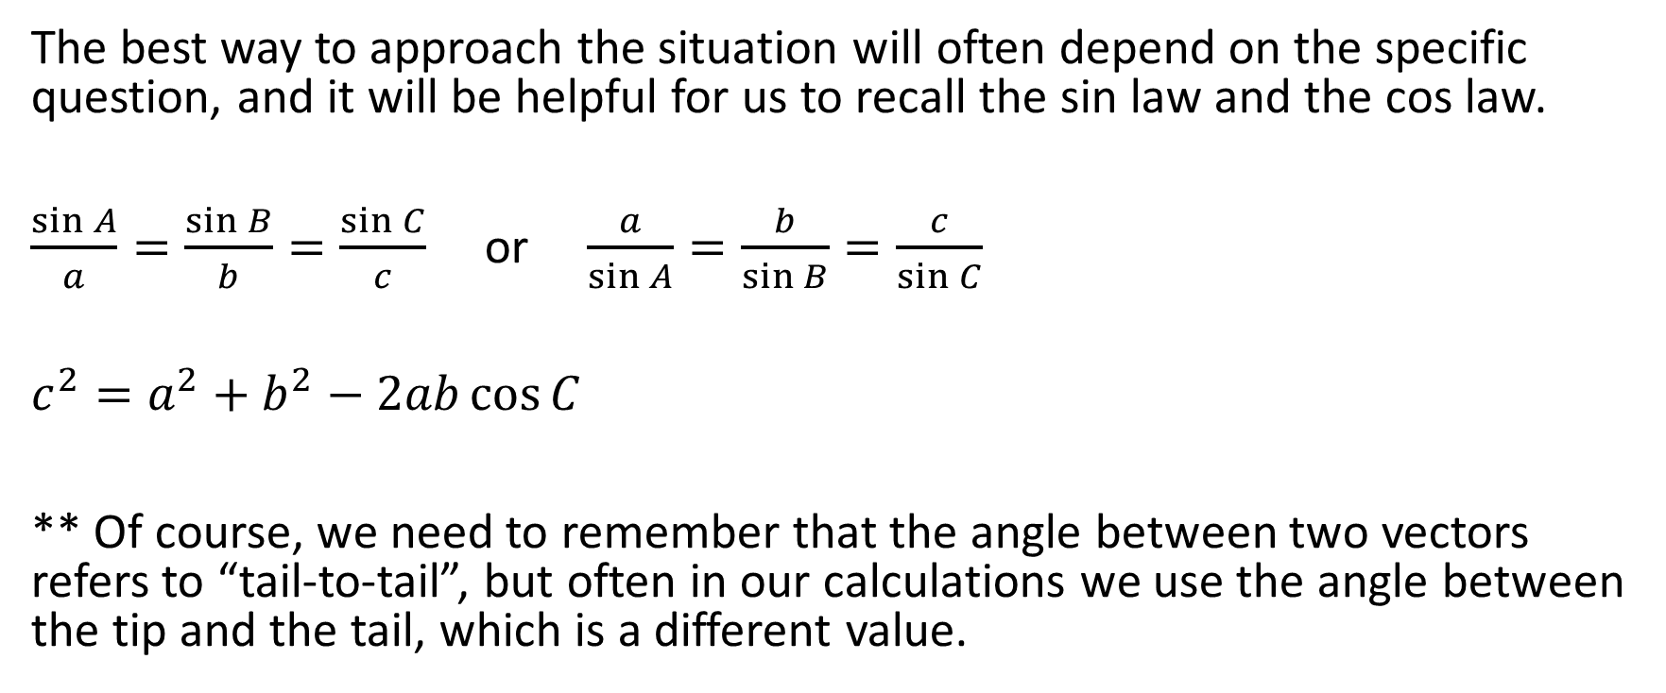
The best way to approach the situation will often depend on the specific question, and it will be helpful for us to recall the sin law and the cos law.
$\frac{\sin{A}}{a}=\frac{\sin{B}}{b}=\frac{\sin{C}}{c}$ or $\frac{a}{\sin{A}}=\frac{b}{\sin{B}}=\frac{c}{\sin{C}}$
$c^{2}=a^{2}+b^{2}−2ab\cos{C}$
** Of course, we need to remember that the angle between two vectors refers to “tail-to-tail”, but often in our calculations we use the angle between the tip and the tail, which is a different value.

Slide 10
Example:
Two forces of 20N and 40N act at an angle of 30º to each other. Determine the resultant of these two forces.

Slide 11

Example:
Two forces of 20N and 40N act at an angle of 30º to each other. Determine the resultant of these two forces.
Solution:
20 N
40 N

Slide 12
Example:
Two forces of 20N and 40N act at an angle of 30º to each other. Determine the resultant of these two forces.
Solution:
We need to move the vectors tip-to-tail
to add them.
20 N
40 N

Slide 13

Example:
Two forces of 20N and 40N act at an angle of 30º to each other. Determine the resultant of these two forces.
Solution:
We need to move the vectors tip-to-tail
to add them.
20 N
40 N
20 N
40 N

Slide 14

Example:
Two forces of 20N and 40N act at an angle of 30º to each other. Determine the resultant of these two forces.
Solution:
We need to move the vectors tip-to-tail
to add them.
20 N
40 N
20 N
40 N

Slide 15

Example:
Two forces of 20N and 40N act at an angle of 30º to each other. Determine the resultant of these two forces.
Solution:
We need to move the vectors tip-to-tail
to add them.
20 N
40 N

Slide 16





Example:
Two forces of 20N and 40N act at an angle of 30º to each other. Determine the resultant of these two forces.
Solution:
We need to move the vectors tip-to-tail
to add them.
20 N
40 N

Slide 17

Example:
Two forces of 20N and 40N act at an angle of 30º to each other. Determine the resultant of these two forces.
Solution:
We need to move the vectors tip-to-tail
to add them.
20 N
40 N

Slide 18





Example:
Two forces of 20N and 40N act at an angle of 30º to each other. Determine the resultant of these two forces.
Solution:
We need to move the vectors tip-to-tail
to add them.
20 N
40 N

Slide 19
Example:
Two forces of 20N and 40N act at an angle of 30º to each other. Determine the resultant of these two forces.
Solution:
We need to move the vectors tip-to-tail
to add them.
We need to put the original vectors tail to tail
20 N
40 N

Slide 20
Example:
Two forces of 20N and 40N act at an angle of 30º to each other. Determine the resultant of these two forces.
Solution:
We need to move the vectors tip-to-tail
to add them.
We need to put the original vectors tail to tail
20 N
40 N

Slide 21

Example:
Two forces of 20N and 40N act at an angle of 30º to each other. Determine the resultant of these two forces.
Solution:
We need to move the vectors tip-to-tail
to add them.
We need to put the original vectors tail to tail
20 N
20 N
40 N

Slide 22
Example:
Two forces of 20N and 40N act at an angle of 30º to each other. Determine the resultant of these two forces.
Solution:
We need to move the vectors tip-to-tail
to add them.
20 N
40 N

Slide 23
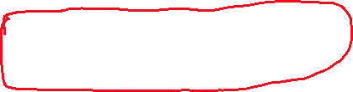
Example:
Two forces of 20N and 40N act at an angle of 30º to each other. Determine the resultant of these two forces.
Solution:
We need to move the vectors tip-to-tail
to add them.
Therefore the resultant is approximately 58.19 N,
In a direction rotated approximately 9.9° from the
40 N force to the 20 N force
20 N
40 N

Slide 24
Equilibrium
A group of forces are said to be in equilibrium when there is no movement.

Slide 25
A group of forces are said to be in equilibrium when there is no movement.
Two forces in equilibrium could look like this:

Slide 26
A group of forces are said to be in equilibrium when there is no movement.
Three forces in equilibrium could look like this:

Slide 27
A group of forces are said to be in equilibrium when there is no movement.
Four forces in equilibrium could look like this:

Slide 28
As you may notice, when there are two forces in equilibrium, they are opposite vectors.
When there are more than two forces in equilibrium, they form a closed polygon.

Slide 29
Example:
Is it possible for three forces of 2 N, 3 N and 4 N to be in equilibrium?

Slide 30
Is it possible for three forces of 2 N, 3 N and 4 N to be in equilibrium?
Solution:
Because it is possible to create a triangle with sides of 2, 3 and 4, therefore it’s possible for forces of 2 N, 3 N and 4 N to be in equilibrium
2 N
3 N
4 N

Slide 31
Example:
Is it possible for three forces of 15 N, 18 N and 36 N to be in equilibrium?

Slide 32
Is it possible for three forces of 15 N, 18 N and 36 N to be in equilibrium?
Solution:
Since (15 + 18) < 36, therefore it is impossible to create a triangle of side lengths 15, 18 and 36. Therefore it is impossible for forces of 15 N, 18 N and 36 N to be in equilibrium.

Slide 33
Example:
Given that three forces of 2 N, 3 N and 4 N are in equilibrium, determine the angle between the two smallest forces?

Slide 34
Example:
Given that three forces of 2 N, 3 N and 4 N are in equilibrium, determine the angle between the two smallest forces?
Solution:
2 N
3 N
4 N

Slide 35
Example:
Given that three forces of 2 N, 3 N and 4 N are in equilibrium, determine the angle between the two smallest forces?
Solution:
2 N
3 N
4 N

Slide 36


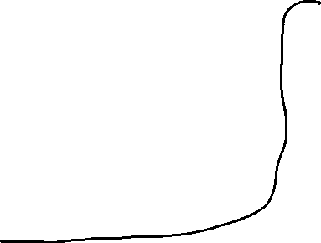







Example:
Given that three forces of 2 N, 3 N and 4 N are in equilibrium, determine the angle between the two smallest forces?
Solution:
2 N
3 N
4 N

Slide 37


Example:
Given that three forces of 2 N, 3 N and 4 N are in equilibrium, determine the angle between the two smallest forces?
Solution:
2 N
3 N
4 N

Slide 38
Example:
Given that three forces of 2 N, 3 N and 4 N are in equilibrium, determine the angle between the two smallest forces?
Solution: When the 2 N force and the 3 N
force are tip-to-tail, the angle is
approximately 104.5°
2 N
3 N
4 N

Slide 39
Example:
Given that three forces of 2 N, 3 N and 4 N are in equilibrium, determine the angle between the two smallest forces?
Solution: When the 2 N force and the 3 N
force are tip-to-tail, the angle is
approximately 104.5°

Slide 40
Example:
Given that three forces of 2 N, 3 N and 4 N are in equilibrium, determine the angle between the two smallest forces?
Solution: When the 2 N force and the 3 N
force are tip-to-tail, the angle is
approximately 104.5°
But what if we put them tail to tail?

Slide 41
Example:
Given that three forces of 2 N, 3 N and 4 N are in equilibrium, determine the angle between the two smallest forces?
Solution: When the 2 N force and the 3 N
force are tip-to-tail, the angle is
approximately 104.5°
But what if we put them tail to tail?

Slide 42

Example:
Given that three forces of 2 N, 3 N and 4 N are in equilibrium, determine the angle between the two smallest forces?
Solution: When the 2 N force and the 3 N
force are tip-to-tail, the angle is
approximately 104.5°
But what if we put them tail to tail?

Slide 43
Example:
Given that three forces of 2 N, 3 N and 4 N are in equilibrium, determine the angle between the two smallest forces?
Solution: By the C-pattern, we know that
α + 104.5° = 180°

Slide 44
Example:
Given that three forces of 2 N, 3 N and 4 N are in equilibrium, determine the angle between the two smallest forces?
Solution: By the C-pattern, we know that
α + 104.5° = 180°
Therefore, α = 75.5°

Slide 45
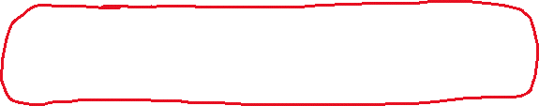
Example:
Given that three forces of 2 N, 3 N and 4 N are in equilibrium, determine the angle between the two smallest forces?
Solution: By the C-pattern, we know that
α + 104.5° = 180°
Therefore, α = 75.5°
Therefore, the angle between the
two smallest forces is approx. 75.5°

Slide 46
Resolving a Vector into its Component Vectors
It is often convenient to break a vector down into one or more vectors that together comprise the original vector.
In two dimensions, this is most commonly done by considering the horizontal and vertical components of a vector.
In three dimensions, this is most commonly done by considering the components along each of the three axes.

Slide 47


Resolving a Vector into its Component Vectors
Consider the vector $\vec{f}$ shown at the right
$$\vec{f}$$

Slide 48

Resolving a Vector into its Component Vectors
Consider the vector $\vec{f}$ shown at the right
We can break $\vec{f}$ down into a horizontal and
a vertical component vector
$$\vec{f}$$

Slide 49



Resolving a Vector into its Component Vectors
Consider the vector $\vec{f}$ shown at the right
We can break $\vec{f}$ down into a horizontal and
a vertical component vector
$$\vec{f}$$
$$\vec{f_{y}}$$
$$\vec{f_{x}}$$

Slide 50
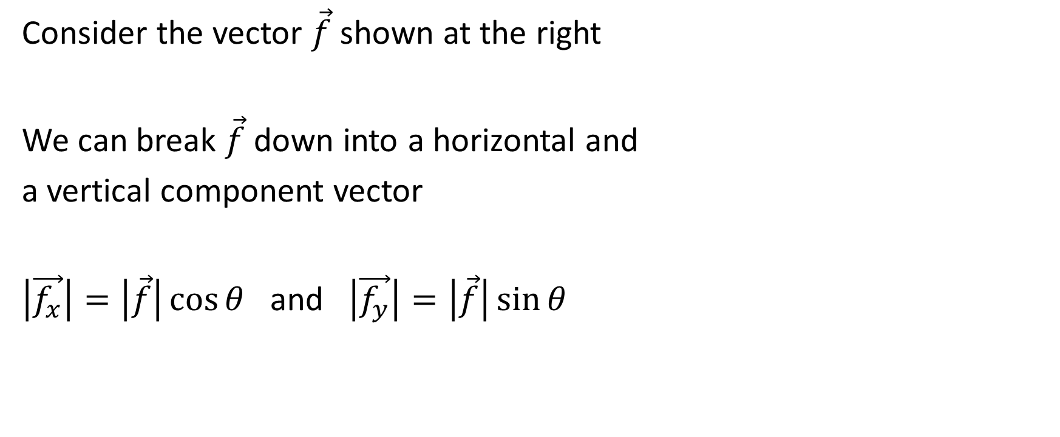
Resolving a Vector into its Component Vectors
Consider the vector $\vec{f}$ shown at the right
We can break $\vec{f}$ down into a horizontal and
a vertical component vector
$\left|\vec{f_{x}}\right|=\left|\vec{f}\right|\cos{θ}$ and $\left|\vec{f_{y}}\right|=\left|\vec{f}\right|\sin{θ}$
$$\vec{f}$$
$$\vec{f_{y}}$$
$$\vec{f_{x}}$$

Slide 51
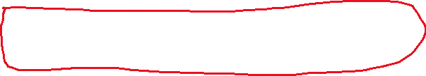
Resolving a Vector into its Component Vectors
Consider the vector $\vec{f}$ shown at the right
We can break $\vec{f}$ down into a horizontal and
a vertical component vector
$\left|\vec{f_{x}}\right|=\left|\vec{f}\right|\cos{θ}$ and $\left|\vec{f_{y}}\right|=\left|\vec{f}\right|\sin{θ}$
$$\vec{f}$$
$$\vec{f_{y}}$$
$$\vec{f_{x}}$$

Slide 52
Example:
Kayla pulls on a rope attached to her sleigh with a force of 200N. If the rope makes an angle of 20º with the horizontal, determine:
a) the force that pulls the sleigh forward
b) the force that tends to lift the sleigh

Slide 53

,

Slide 54

,

Slide 55



,

Slide 56




,

Slide 57
,
Therefore the force that pulls the sleigh forward is approximately 187.9 N
The force that tends to lift the sleigh is approximately 68.4 N

Slide 58
Example 4 from page 359 A mass of 20 kg is suspended from a ceiling by two lengths of rope that make angles of 60º and 45º with the ceiling. Determine the magnitude of the tension in each rope

Slide 59


Example 4 from page 359 A mass of 20 kg is suspended from a ceiling by two lengths of rope that make angles of 60º and 45º with the ceiling. Determine the magnitude of the tension in each rope
Solution:

Slide 60
Example 4 from page 359 A mass of 20 kg is suspended from a ceiling by two lengths of rope that make angles of 60º and 45º with the ceiling. Determine the magnitude of the tension in each rope
Solution:
A mass of 20 kg exerts a force of approx. (20 kg) x (9.81 m/s²)
= 196.2 N

Slide 61
Example 4 from page 359 A mass of 20 kg is suspended from a ceiling by two lengths of rope that make angles of 60º and 45º with the ceiling. Determine the magnitude of the tension in each rope
Solution:
The tension runs up each rope
196.2 N

Slide 62
Example 4 from page 359 A mass of 20 kg is suspended from a ceiling by two lengths of rope that make angles of 60º and 45º with the ceiling. Determine the magnitude of the tension in each rope
Solution:
196.2 N

Slide 63
Example 4 from page 359 A mass of 20 kg is suspended from a ceiling by two lengths of rope that make angles of 60º and 45º with the ceiling. Determine the magnitude of the tension in each rope
Solution:
Method 1:
Using the Z-Pattern, we see the following with respect to the angles in the diagram.
196.2 N

Slide 64


Example 4 from page 359 A mass of 20 kg is suspended from a ceiling by two lengths of rope that make angles of 60º and 45º with the ceiling. Determine the magnitude of the tension in each rope
Solution:
Method 1:
Using the Z-Pattern, we see the following with respect to the angles in the diagram.
196.2 N

Slide 65
Example 4 from page 359 A mass of 20 kg is suspended from a ceiling by two lengths of rope that make angles of 60º and 45º with the ceiling. Determine the magnitude of the tension in each rope
Solution:
Method 1:
Now we can move the vectors around to create equilibrium (there must be equilibrium or there is movement). This means that we will have a closed triangle of vectors drawn tip to tail.
196.2 N

Slide 66
Example 4 from page 359 A mass of 20 kg is suspended from a ceiling by two lengths of rope that make angles of 60º and 45º with the ceiling. Determine the magnitude of the tension in each rope
Solution:
Method 1:
196.2 N

Slide 67
Example 4 from page 359 A mass of 20 kg is suspended from a ceiling by two lengths of rope that make angles of 60º and 45º with the ceiling. Determine the magnitude of the tension in each rope
Solution:
Method 1:
Draw imaginary horizontal lines
196.2 N

Slide 68
Example 4 from page 359 A mass of 20 kg is suspended from a ceiling by two lengths of rope that make angles of 60º and 45º with the ceiling. Determine the magnitude of the tension in each rope
Solution:
Method 1:
196.2 N

Slide 69
Example 4 from page 359 A mass of 20 kg is suspended from a ceiling by two lengths of rope that make angles of 60º and 45º with the ceiling. Determine the magnitude of the tension in each rope
Solution:
Method 1:
Insert angles from the left-hand diagram to their corresponding spot in the right-hand diagram
196.2 N

Slide 70

Example 4 from page 359 A mass of 20 kg is suspended from a ceiling by two lengths of rope that make angles of 60º and 45º with the ceiling. Determine the magnitude of the tension in each rope
Solution:
Method 1:
Insert angles from the left-hand diagram to their corresponding spot in the right-hand diagram
196.2 N

Slide 71

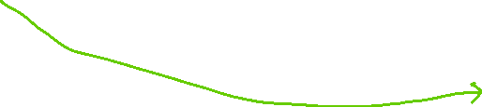
Example 4 from page 359 A mass of 20 kg is suspended from a ceiling by two lengths of rope that make angles of 60º and 45º with the ceiling. Determine the magnitude of the tension in each rope
Solution:
Method 1:
Insert angles from the left-hand diagram to their corresponding spot in the right-hand diagram
196.2 N

Slide 72


Example 4 from page 359 A mass of 20 kg is suspended from a ceiling by two lengths of rope that make angles of 60º and 45º with the ceiling. Determine the magnitude of the tension in each rope
Solution:
Method 1:
Insert angles from the left-hand diagram to their corresponding spot in the right-hand diagram
196.2 N

Slide 73



Example 4 from page 359 A mass of 20 kg is suspended from a ceiling by two lengths of rope that make angles of 60º and 45º with the ceiling. Determine the magnitude of the tension in each rope
Solution:
Method 1:
196.2 N

Slide 74
Example 4 from page 359 A mass of 20 kg is suspended from a ceiling by two lengths of rope that make angles of 60º and 45º with the ceiling. Determine the magnitude of the tension in each rope
Solution:
Method 1:
Add the 60° and the 45°
196.2 N

Slide 75

Example 4 from page 359 A mass of 20 kg is suspended from a ceiling by two lengths of rope that make angles of 60º and 45º with the ceiling. Determine the magnitude of the tension in each rope
Solution:
Method 1:
196.2 N

Slide 76
Example 4 from page 359 A mass of 20 kg is suspended from a ceiling by two lengths of rope that make angles of 60º and 45º with the ceiling. Determine the magnitude of the tension in each rope
Solution:
Method 1:
The green 45° angle at the bottom is part of a 90° angle (i.e., the vertical 196.2 N force meets the horizontal line at 90°)
196.2 N

Slide 77
Example 4 from page 359 A mass of 20 kg is suspended from a ceiling by two lengths of rope that make angles of 60º and 45º with the ceiling. Determine the magnitude of the tension in each rope
Solution:
Method 1:
Therefore the other side of the angle is 45° (because 90° - 45° = 45°)
196.2 N

Slide 78

Example 4 from page 359 A mass of 20 kg is suspended from a ceiling by two lengths of rope that make angles of 60º and 45º with the ceiling. Determine the magnitude of the tension in each rope
Solution:
Method 1:
Therefore the other side of the angle is 45° (because 90° - 45° = 45°)
196.2 N

Slide 79
Example 4 from page 359 A mass of 20 kg is suspended from a ceiling by two lengths of rope that make angles of 60º and 45º with the ceiling. Determine the magnitude of the tension in each rope
Solution:
Method 1:
196.2 N

Slide 80
Example 4 from page 359 A mass of 20 kg is suspended from a ceiling by two lengths of rope that make angles of 60º and 45º with the ceiling. Determine the magnitude of the tension in each rope
Solution:
Method 1:
The three angles in the triangle add to 180° so the third angle must be 180° - 105° - 45° = 30°.
196.2 N

Slide 81
Example 4 from page 359 A mass of 20 kg is suspended from a ceiling by two lengths of rope that make angles of 60º and 45º with the ceiling. Determine the magnitude of the tension in each rope
Solution:
Method 1:
196.2 N

Slide 82






Example 4 from page 359 A mass of 20 kg is suspended from a ceiling by two lengths of rope that make angles of 60º and 45º with the ceiling. Determine the magnitude of the tension in each rope
Solution:
Method 1:
196.2 N

Slide 83



Example 4 from page 359 A mass of 20 kg is suspended from a ceiling by two lengths of rope that make angles of 60º and 45º with the ceiling. Determine the magnitude of the tension in each rope
Solution:
Method 1:
196.2 N

Slide 84
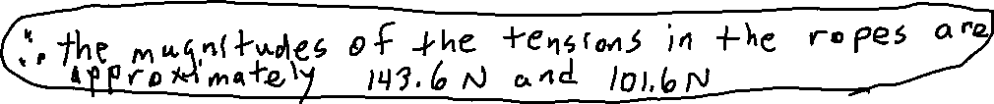
Example 4 from page 359 A mass of 20 kg is suspended from a ceiling by two lengths of rope that make angles of 60º and 45º with the ceiling. Determine the magnitude of the tension in each rope
Solution:
Method 1:
196.2 N

Slide 85
Example 4 from page 359 A mass of 20 kg is suspended from a ceiling by two lengths of rope that make angles of 60º and 45º with the ceiling. Determine the magnitude of the tension in each rope
Solution:
Method 2:
196.2 N

Slide 86
Example 4 from page 359 A mass of 20 kg is suspended from a ceiling by two lengths of rope that make angles of 60º and 45º with the ceiling. Determine the magnitude of the tension in each rope
Solution:
Method 2:
We can use the components method.
196.2 N

Slide 87
Example 4 from page 359 A mass of 20 kg is suspended from a ceiling by two lengths of rope that make angles of 60º and 45º with the ceiling. Determine the magnitude of the tension in each rope
Solution:
Method 2:
We can use the components method.
We know that the net horizontal force of the two tension forces is 0, because the gravitational force provides 0 net horizontal force and there is 0 net horizontal force overall.
196.2 N

Slide 88
Example 4 from page 359 A mass of 20 kg is suspended from a ceiling by two lengths of rope that make angles of 60º and 45º with the ceiling. Determine the magnitude of the tension in each rope
Solution:
Method 2:
We can use the components method.
We know that the net horizontal force of the two tension forces is 0, because the gravitational force provides 0 net horizontal force and there is 0 net horizontal force overall.
196.2 N

Slide 89

Example 4 from page 359 A mass of 20 kg is suspended from a ceiling by two lengths of rope that make angles of 60º and 45º with the ceiling. Determine the magnitude of the tension in each rope
Solution:
Method 2:
We can use the components method.
We know that the net horizontal force of the two tension forces is 0, because the gravitational force provides 0 net horizontal force and there is 0 net horizontal force overall.
196.2 N

Slide 90
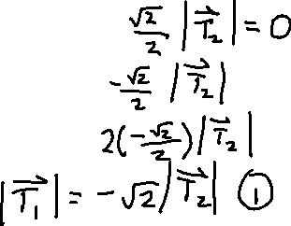
Example 4 from page 359 A mass of 20 kg is suspended from a ceiling by two lengths of rope that make angles of 60º and 45º with the ceiling. Determine the magnitude of the tension in each rope
Solution:
Method 2:
Since there is no horizontal movement, therefore the magnitude of the horizontal component of the tension in the first rope must be equal to the magnitude of the horizontal component in the second rope.
196.2 N

Slide 91




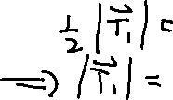



Example 4 from page 359 A mass of 20 kg is suspended from a ceiling by two lengths of rope that make angles of 60º and 45º with the ceiling. Determine the magnitude of the tension in each rope
Solution:
Method 2:
196.2 N

Slide 92
Example 4 from page 359 A mass of 20 kg is suspended from a ceiling by two lengths of rope that make angles of 60º and 45º with the ceiling. Determine the magnitude of the tension in each rope
Solution:
Method 2:
We know that the net vertical force of the tensions is approx. 196.2 N to counteract the force due to gravity and create equilibrium.
196.2 N

Slide 93









Example 4 from page 359 A mass of 20 kg is suspended from a ceiling by two lengths of rope that make angles of 60º and 45º with the ceiling. Determine the magnitude of the tension in each rope
Solution:
Method 2:
196.2 N

Slide 94

Example 4 from page 359 A mass of 20 kg is suspended from a ceiling by two lengths of rope that make angles of 60º and 45º with the ceiling. Determine the magnitude of the tension in each rope
Solution:
Method 2:
sub in $\left|\vec{T_{1}}\right|=\sqrt{2}\left|\vec{T_{2}}\right|$
196.2 N

Slide 95
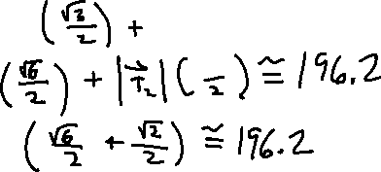





Example 4 from page 359 A mass of 20 kg is suspended from a ceiling by two lengths of rope that make angles of 60º and 45º with the ceiling. Determine the magnitude of the tension in each rope
Solution:
Method 2:
sub in $\left|\vec{T_{1}}\right|=\sqrt{2}\left|\vec{T_{2}}\right|$
196.2 N

Slide 96
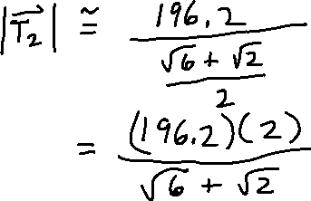
Example 4 from page 359 A mass of 20 kg is suspended from a ceiling by two lengths of rope that make angles of 60º and 45º with the ceiling. Determine the magnitude of the tension in each rope
Solution:
Method 2:
196.2 N

Slide 97





Example 4 from page 359 A mass of 20 kg is suspended from a ceiling by two lengths of rope that make angles of 60º and 45º with the ceiling. Determine the magnitude of the tension in each rope
Solution:
Method 2:
196.2 N

Slide 98
Example 4 from page 359 A mass of 20 kg is suspended from a ceiling by two lengths of rope that make angles of 60º and 45º with the ceiling. Determine the magnitude of the tension in each rope
Solution:
Method 2:
Therefore, the tensions in the two ropes are approximately 101.6 N and 143.6 N
196.2 N

